Slide 1
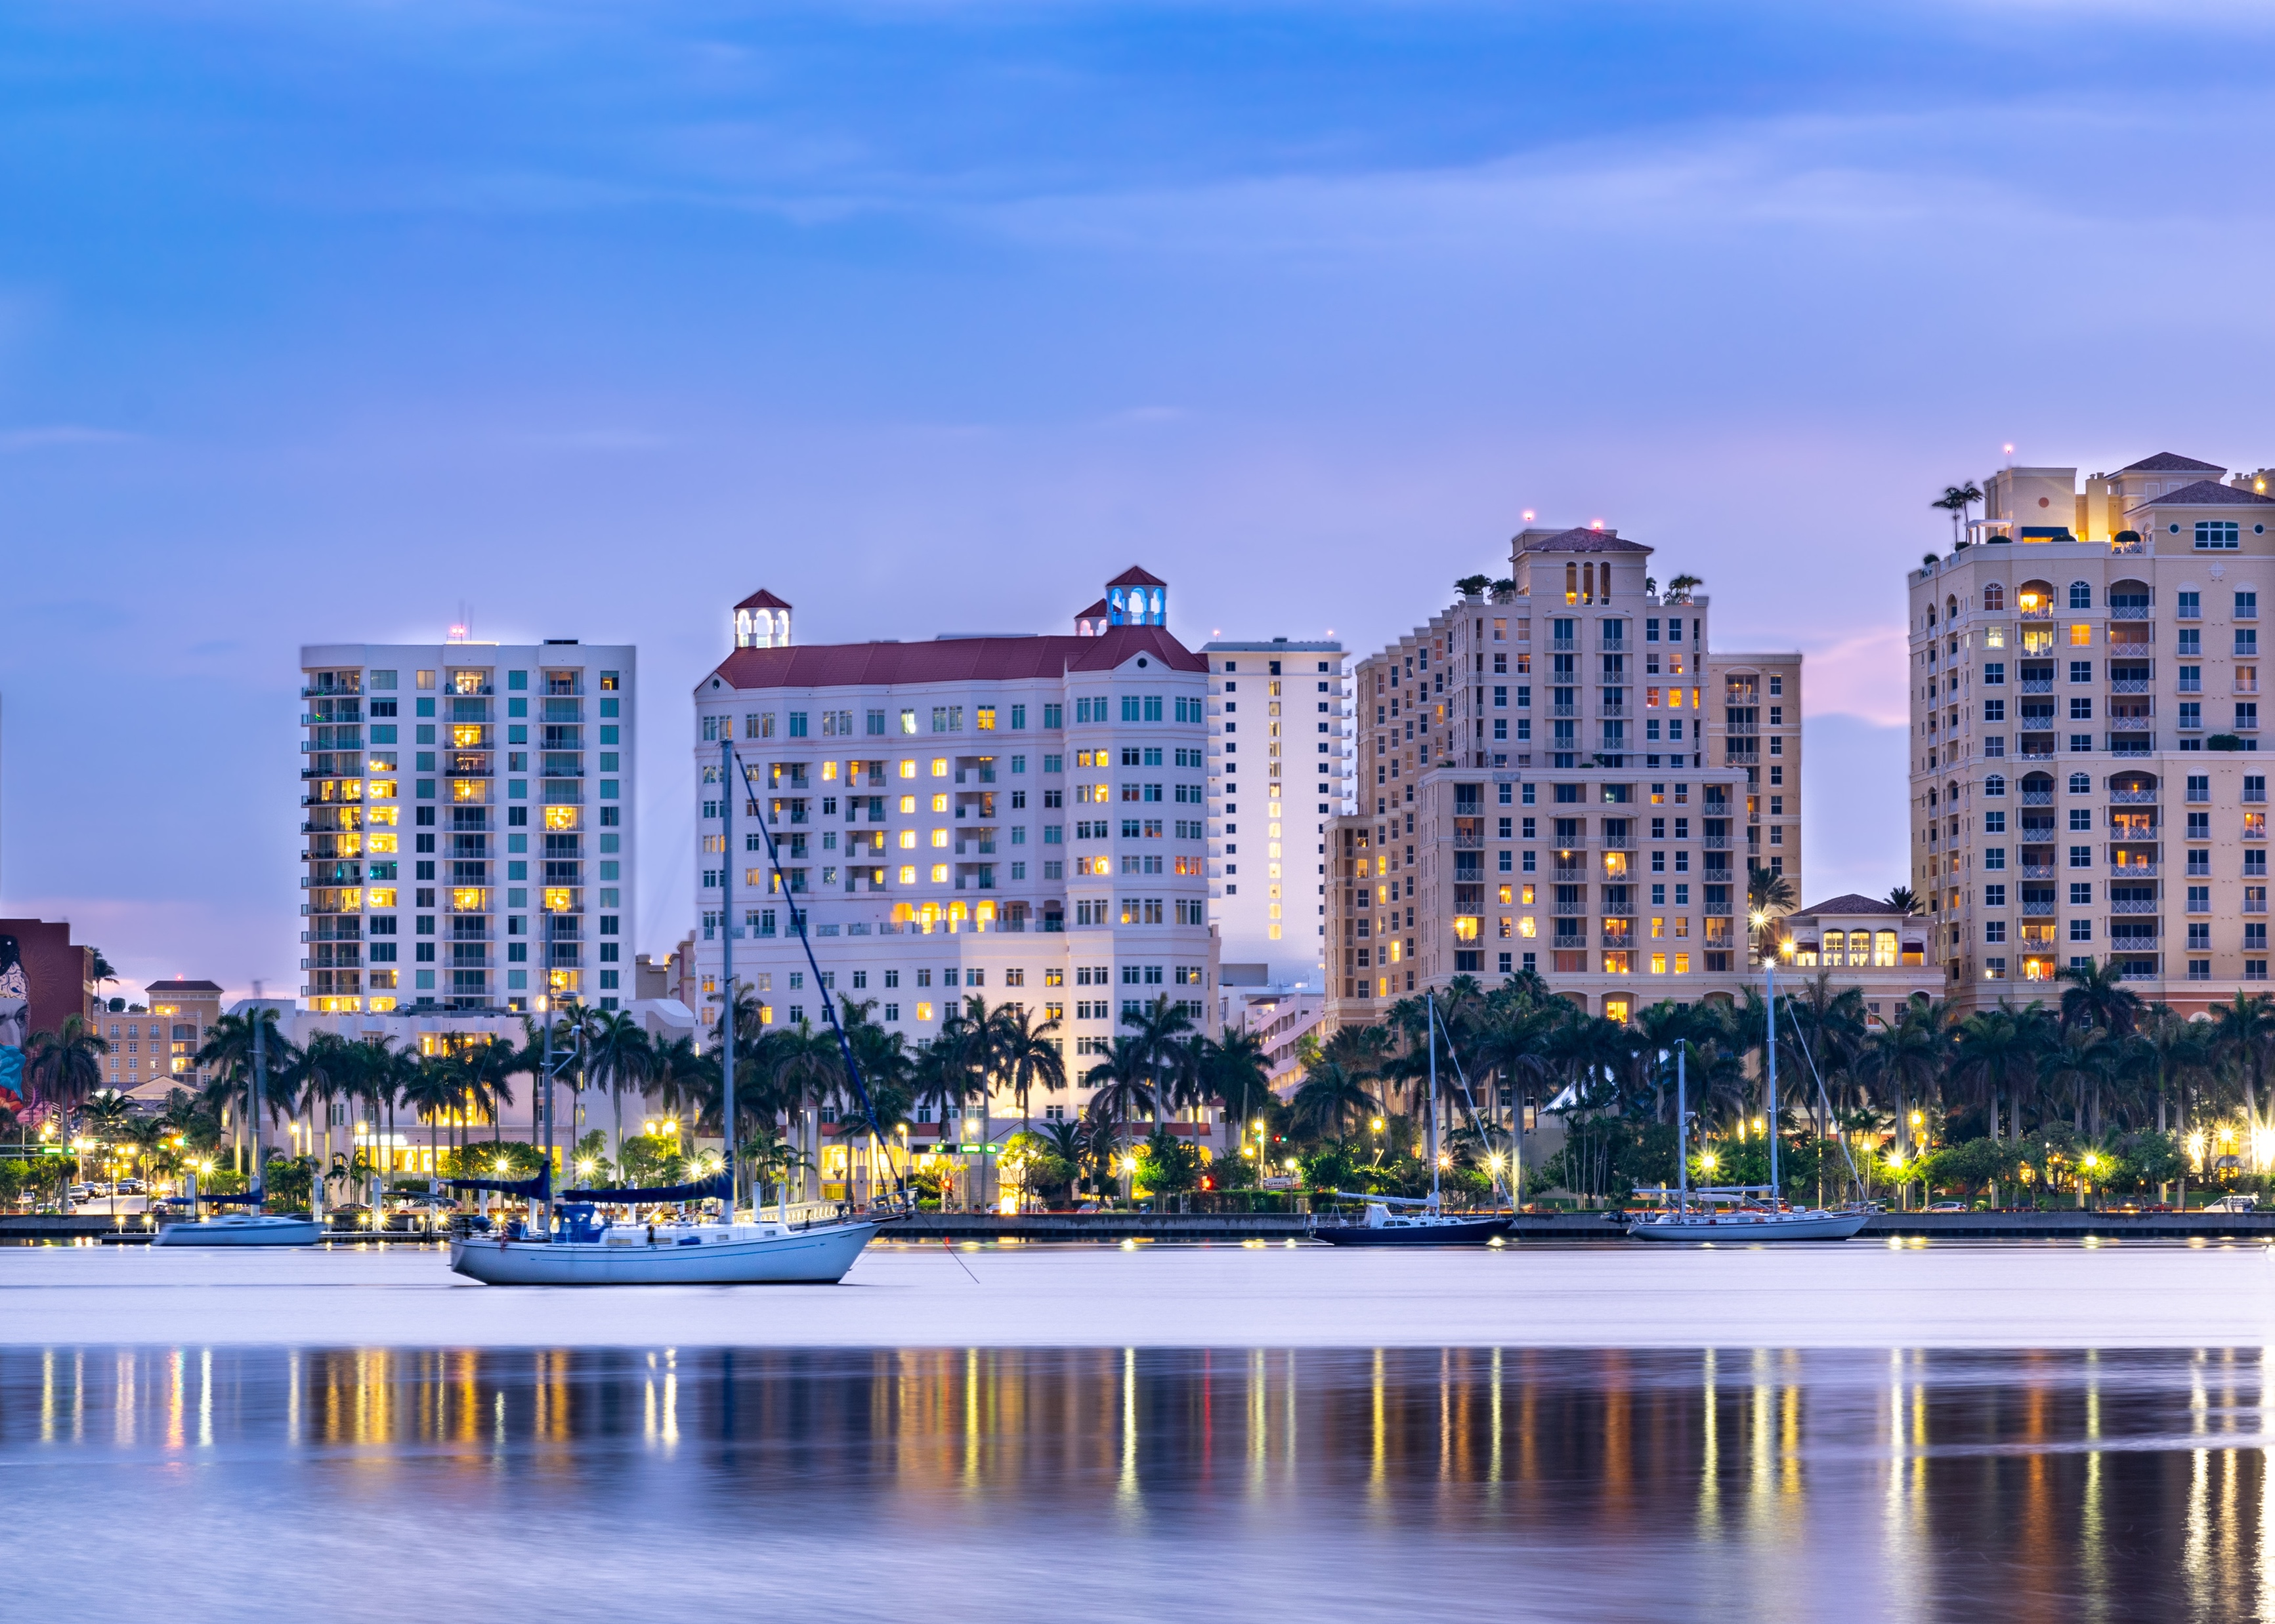
Send text to <palm beach county 3-1-1>
Streamlining the public works request process

Slide 2

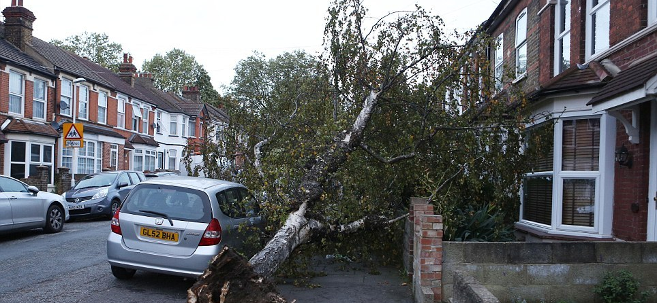
streamlining the public works process

Slide 3
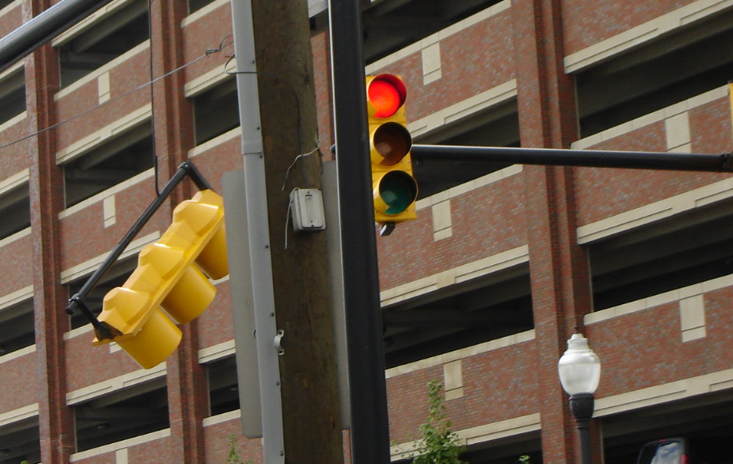
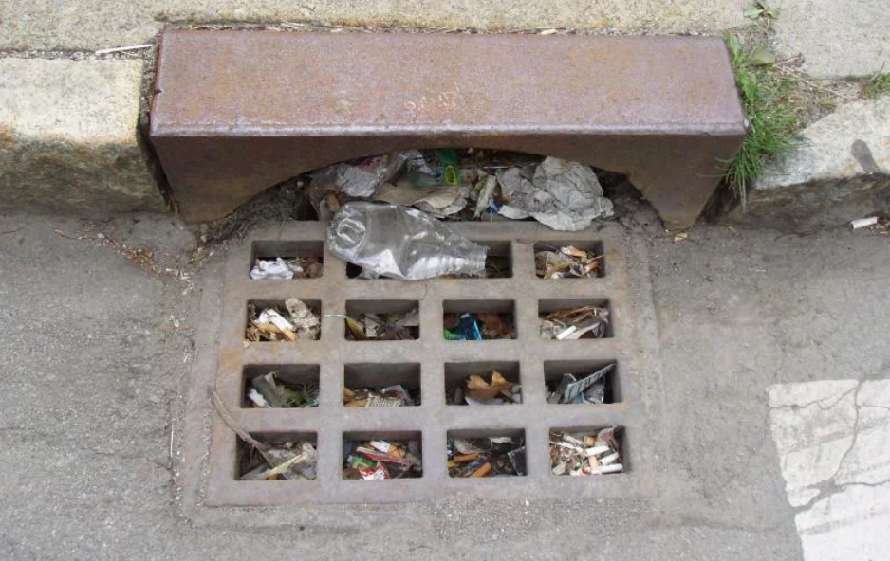
streamlining the public works process

Slide 4
The engineering and public works office of Palm beach county oversees…
3,500 lane miles of roadway
2,250 miles of sidewalk
2,500 acres of mowing
40 miles of shellrock roads
3.5 miles of drainage canals/ditches
Approximately 300 bridges
Guardrails throughout the county road system
1,254 traffic signals

Slide 5
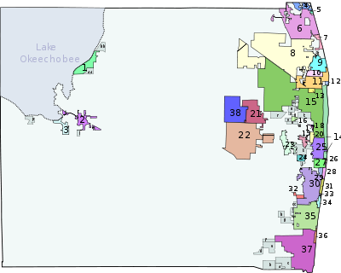

Municipalities in palm beach county

Slide 6
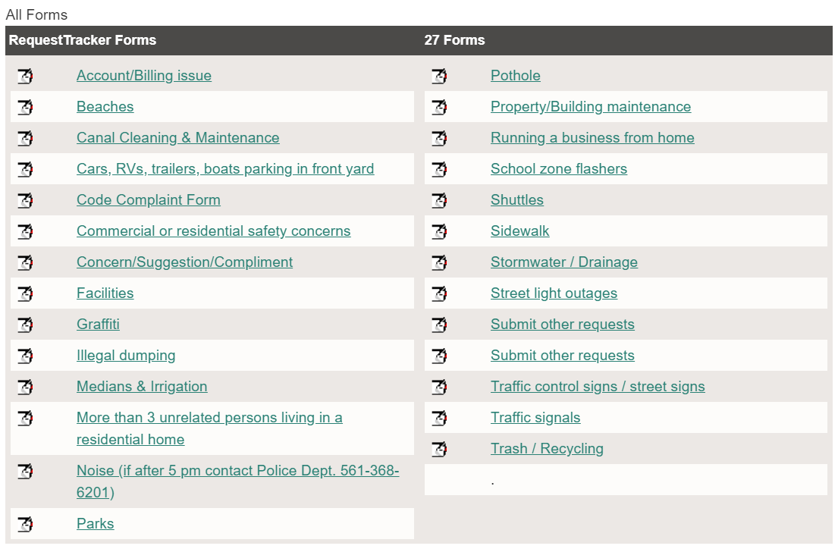
The current system – boca raton website

Slide 7
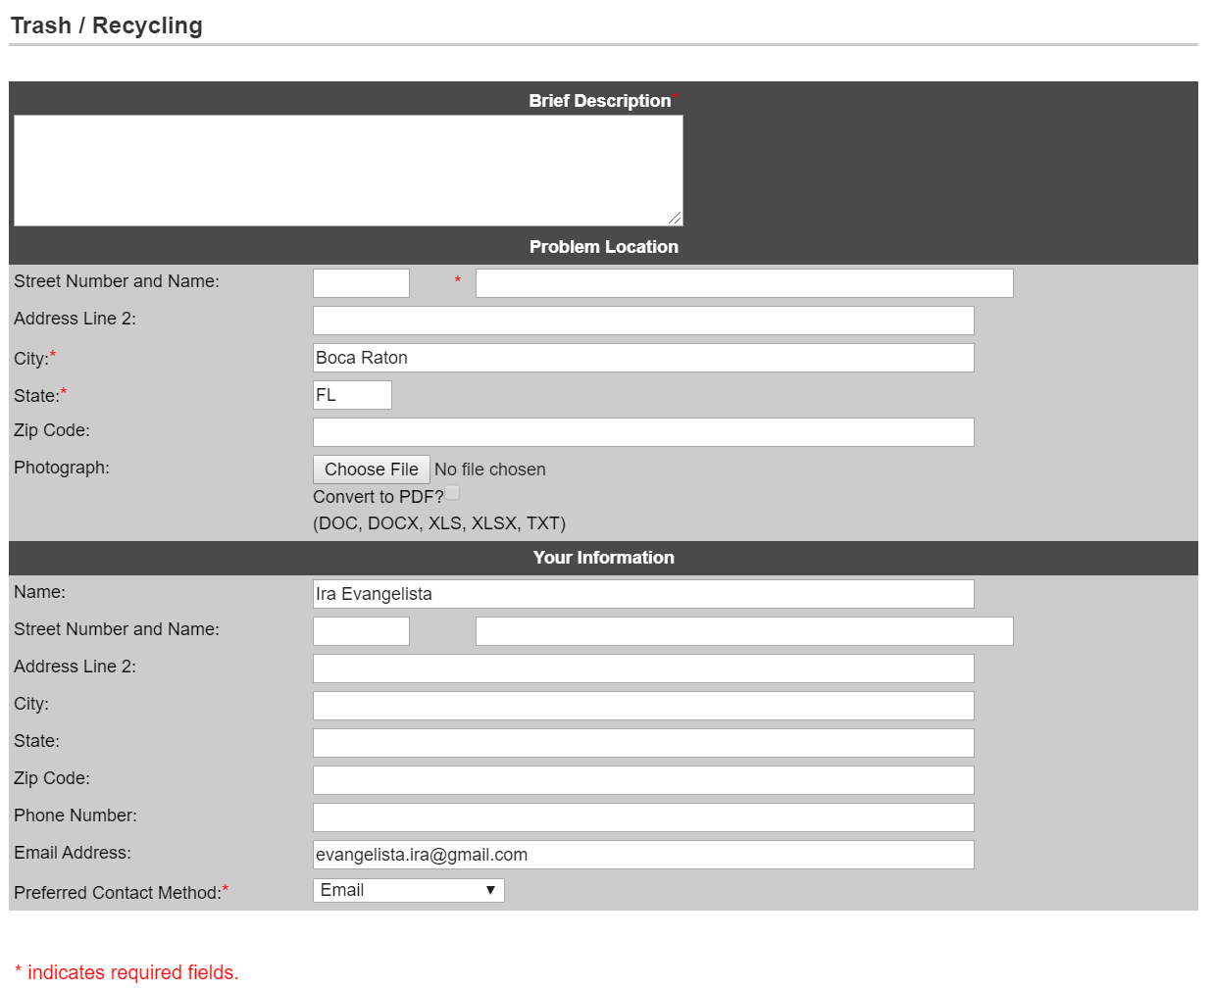
The current system

Slide 8
A Simple Solution
User submits a photo to PALM BEACH COUNTY 311
PBC311 sends back a URL with a form:
Title
Current address (or the location pin button)
Drop down category
Description (optional)

Slide 9
Local govt. view
Eliminates order requests outside of jurisdiction
Increases the number of requests from PBC citizens

Slide 10

Thank you.

